Slide 1
FORMAL AND NON – FORMAL EDUCATION IN LITHUANIA
JONIŠKIS „SAULĖS“ BAISIC SCHOOL
2021 NOVEMBER 14 - 20
ROMANIA

Slide 2
EDUCATION SYSTEM
NON-DEGREE STUDIES (TEACHING AND RESIDENCE)
ADULT EDUCATION
The Lithuanian education system covers formal and non-formal education, self-education and educational assistance
institutions. Formal education is approved by the Ministry of Education framework programs.
Educational assistance institutions provide all kinds of assistance (social, psychological etc.) in formal education.
Self - education is personal development, learning by using libraries, media, the Internet, museums and life experiences taken from others.
Non-formal education includes those institutions where a person can improve existing knowledge or gets new additional competencies according to their personal needs. Non - formal education also includes pre-school education and adult education.
DOCTORAL STUDIES
MASTER 'S STUDIES
BACHELOR STUDIES
VOCATIONAL TRAINING
SECONDARY EDUCATION
NON - FORMAL CHILDREN
EDUCATION
BASIC EDUCATION
PRIMARY EDUCATION
PRE-SCHOOL EDUCATION (PREPARATION FOR SCHOOL)
PRESCHOOL EDUCATION

Slide 3
NON-FORMAL EDUCATION IN LITHUANIA
The purpose of non-formal education is to meet the needs of students for cognition, education and self-expression, to help them become active members of society.
Non-formal education programs for children are implemented by music schools, art schools, sport schools and other schools as well as freelance teachers, and other education providers.

Slide 4
NON- FORMAL EDUCATION FORMS
Every child has got so called non-formal education basket. The recommnded amount for one child is about 15 euro a month. The money can be used by pupils who attend municipallity acrceditated non-formal children education programs. These programs are written only by persons with a pedagogical education.

Slide 5
EDUCATIONAL PROGRAMS THAT COMPLEMENTGENERAL EDUCATION
Such kind of programs are usually implemented in art and sport schools. The funds are received by the municipalities according to the number of students. Parents in these schools pay a fee for their children education which is determined by the founder (municipality), usually it is about 15 percents of all program prices.

Slide 6
AT SCHOOL
According to the educational plan, each school is given funds to pay for the circles. For one class set is given 2 hours a week.

Slide 7
The EU supports for non-formal education activities In 2016 The EU project “Development of Non-formal Education Services for Children” was started to implement by the Lithuanian Center for Non-formal Education. Now the schools which submitted applications can participate in non-formal education. Students can visit theaters, parks, organic farms, workshops, etc. active leisure spaces, manege, swimming pools for free.

Slide 8
STUDENTS COGNITIVE ACTIVITIES
Every general education school is funded to organize all kinds of cognitive activities: , e.g. excursions, educational programs in museums, etc. The amount depends on the number of students at school.

Slide 9
NON- FORMAL EDUCATION IN OUR SCHOOL
“Young naturalists "
Health ABC
"Pause"
"Young Researcher„
Checkers
Friendship bridge
"I keep my health"
"Secrets of Floristry"
"Game maze"
Sport for all
„Grow up healthy and safe"
Sports games
"Health all year round"
“Young naturalists”
Wrestling
English Language Club

Slide 10
Preparation for Mathematics PUPP (examination of the basic education program) 10th grade.
Young journalists
"Self-cognition is the path to health"
The alphabet path (Russian language for the 5th formers)
The alphabet path (English language for the 1st formers)

Slide 11
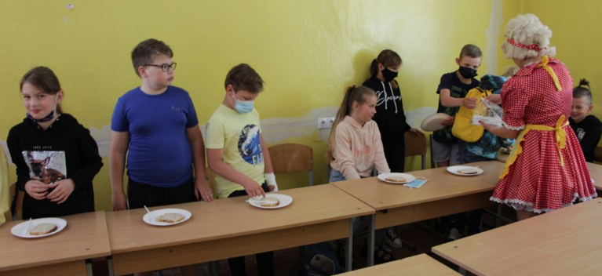
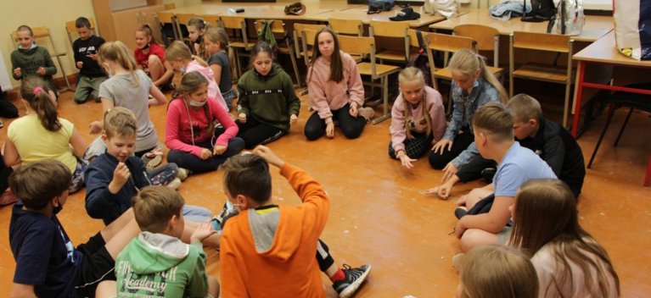
SUMMER CAMPS
Children's summer camp programs. Municipalities usually organize day camps. They are free.

Slide 12
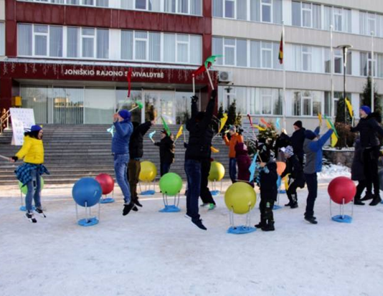
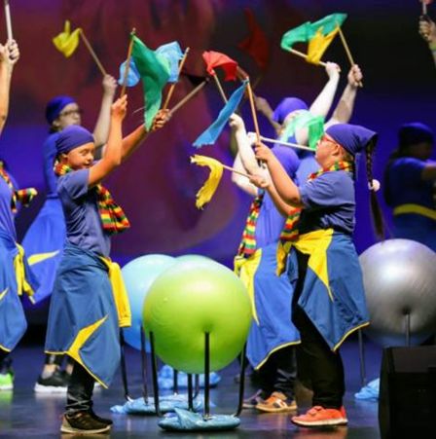
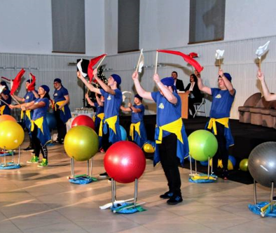
Non formal education for students with special needs
Sports club “Strong and fit”
Catch the rhythm

Slide 13
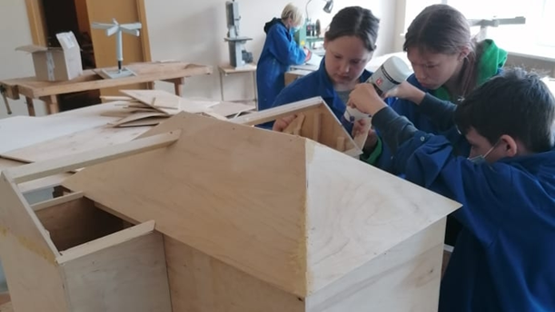
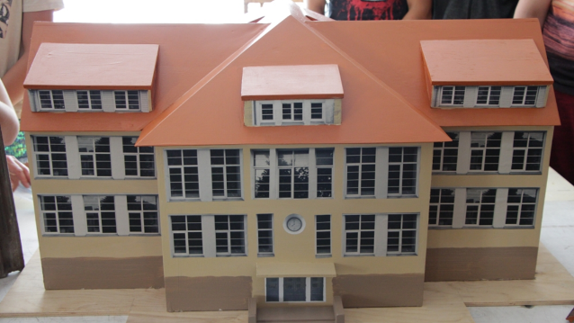
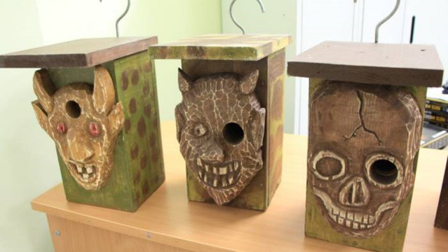
Wood technology lessons for students with special needs and for youth classes

Slide 14
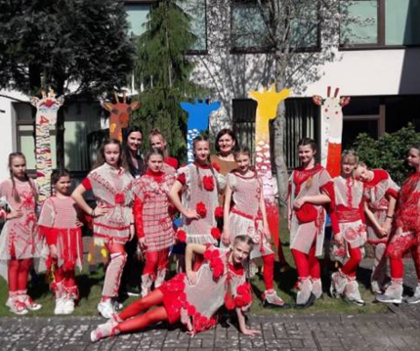
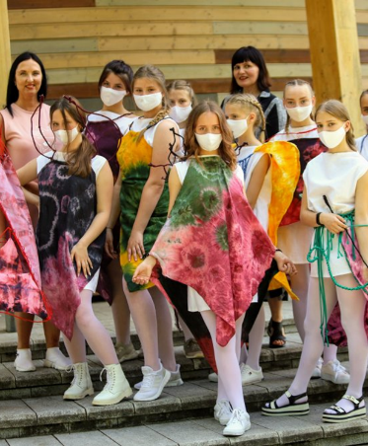
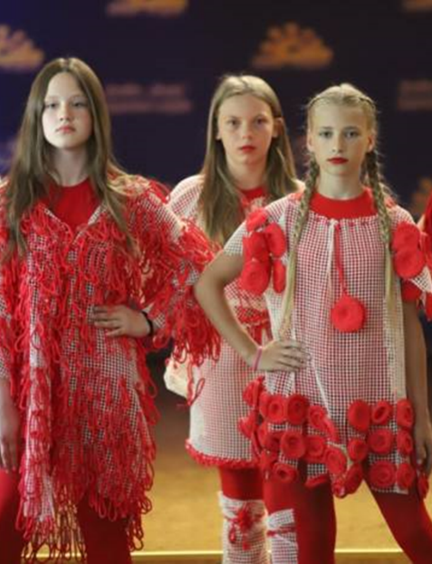
DESIGN CLUB
Pupils and technology teachers, design and sew avant-garde clothes that are displayed during the school's name day celebration in spring.

Slide 15
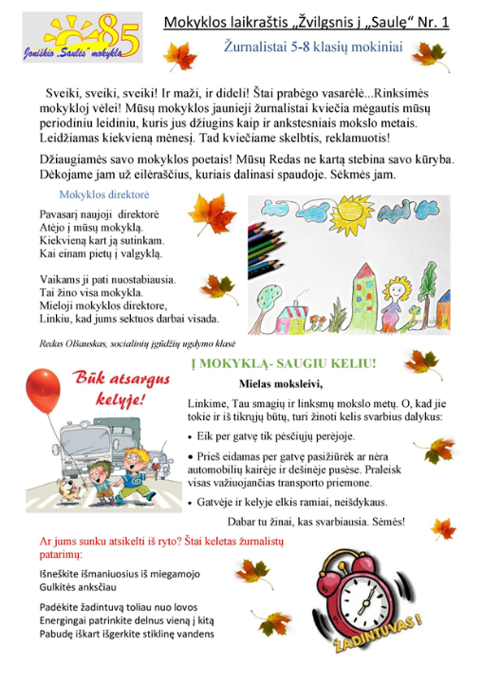
SCHOOL NEWSPAPER: “THE LOOK AT THE SUN” FOR YOUNG JOURNALISTS
Students and teachers send articles about their acitvities and all the most interesting news is published in the school nespaper evry month.

Slide 16
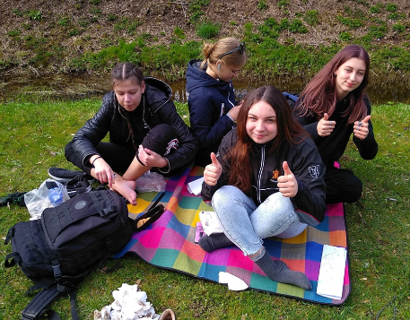
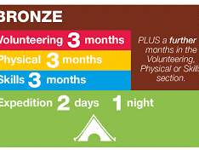
Dofe program The DofE is the world's leading youth achievement award program. Students get new skills in the four sections of the award: volunteering, physical activity, skill and expedition. Our school hasalready been running this program for 13 years.

